Slide 1


Barnabas
01/01/2023

Slide 2

Outline
Executive Summary
Introduction
Methodology
Results
Conclusion
Appendix

Slide 3
Executive Summary
Summary of methodologies
Data collection and wrangling
Eda using SQL and data visualization
Interactive map using folium
Dashboard with Plotly Dash
Machine learning analysis
Summary of all results
EDA results
Predictive analysis results

Slide 4
Introduction
Project background and context
Spacex, one of the most successful space travel related companies have falcon 9 rockets that cost only 62million dollars instead of the regular 165million dollars that Spacex’s competitorsoffer. They get this low cost, because they reuse the launching stage
Problems you want to find answers
How do variables affect the success of landing?
What is the best algorithm to use in this case?

Slide 5

Section 1

Slide 6
Methodology
Executive Summary
Data collection methodology:
Using Rest API
Using Web Scrapping
Perform data wrangling
First the data was filtered, then we dealt with the missing values, then used OneHotEncoding
Perform exploratory data analysis (EDA) using visualization and SQL
Perform interactive visual analytics using Folium and Plotly Dash
Perform predictive analysis using classification models

Slide 7
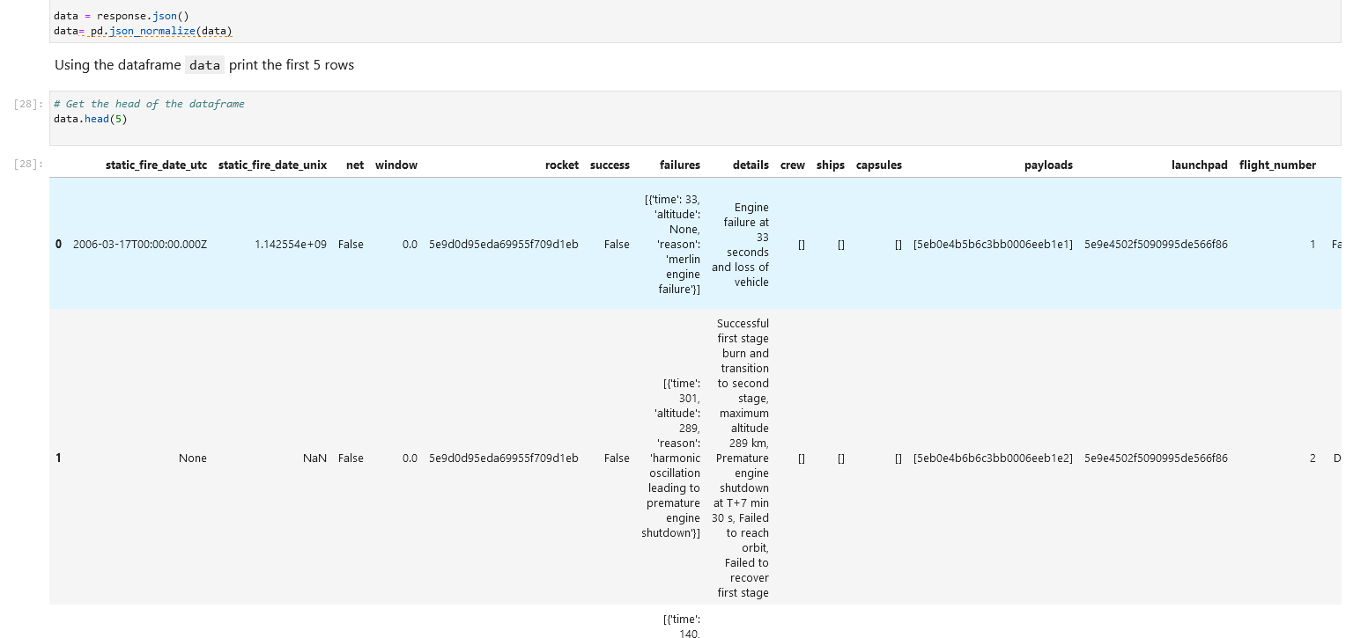
Data Collection
First we collected data using requests from API’s from Spacex rest api, then using Web Scraping

Slide 8
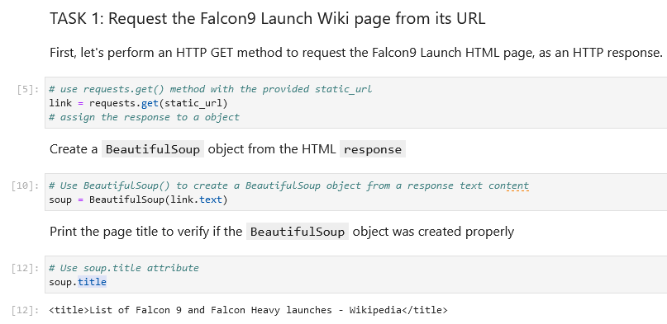

Slide 9
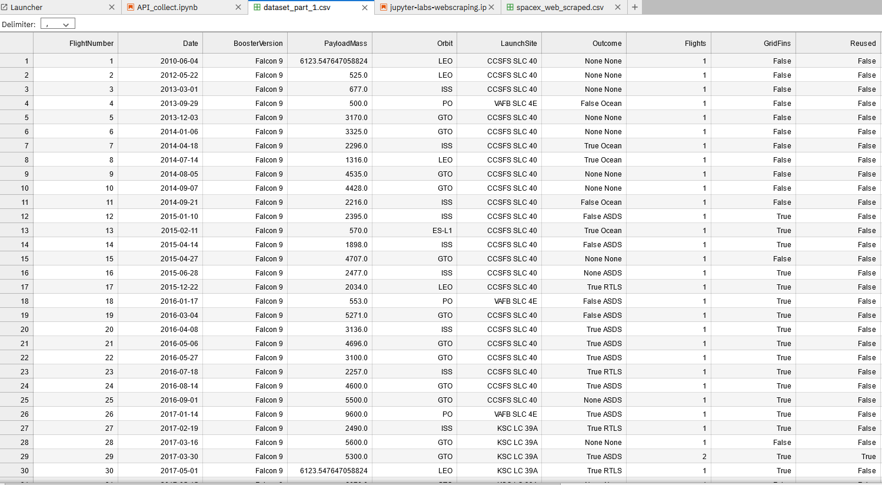
Data Collection – SpaceX API
Request.get(url)
Response.json()
Pd.json_normalize(data)
https://github.com/Bahun98/IBMcourse/blob/bcde97c72d3f474bd7f07cc0b092a48c367d8297/jupyter-labs-webscraping.ipynb

Slide 10
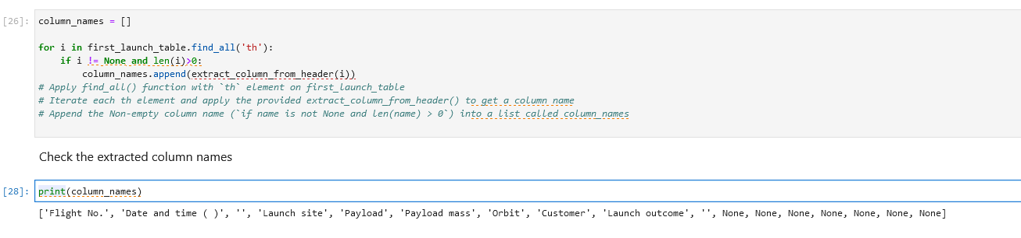
Data Collection - Scraping
Link = requests.get(url)
soup = BeautifulSoup(Link.text)
https://github.com/Bahun98/IBMcourse/blob/bcde97c72d3f474bd7f07cc0b092a48c367d8297/jupyter-labs-webscraping.ipynb
Place your flowchart of web scraping here

Slide 11
Data Wrangling
We dealt with null values, if the landing was successful then we added a column with the value “1”, otherwise value “0”
Process:
Perform EDA
Calc the number of launches on each site
Calc the number of each orbit’s occurrence
Calc the number of each orbit mission type and the occurrence of it
Create a landing outcome label
Export data
https://github.com/Bahun98/IBMcourse/blob/bcde97c72d3f474bd7f07cc0b092a48c367d8297/DataWrangling.ipynb

Slide 12
EDA with Data Visualization
Charts created:
Flight number vs payload
Flight number vs launch site
Paylaod mass vs launch site
Orbit type vs success rate
Etc
We used scatters to visualize relationships, bars to compare discrete categories, line charts to show trends over time
https://github.com/Bahun98/IBMcourse/blob/6ce601cee0b52d8c4e3593888966aa9d84185030/EDAvisual.ipynb

Slide 13
EDA with SQL
Using bullet point format, summarize the SQL queries you performed
Display each unique launch site
Display 5records where launch site name begins with ‘CCA’
Disp total payload mass carried by boosters launched from NASA (CRS)
Disp average payload mass carried by booster version F9 V1.1
List the date of first successful ground landing
List names of boosters which had a success and payload mass between 4000 and 6000
Total number of success and failure outcomes
List booster versions which carried the max payload mass
Failed landing outcome per month in year 2015
Rank outcomes between set date
https://github.com/Bahun98/IBMcourse/blob/6ce601cee0b52d8c4e3593888966aa9d84185030/EDA_SQL.ipynb

Slide 14
Build an Interactive Map with Folium
Markers of all Launch sites
To see where they are
Colored Markers of the launch outcomes for each Launch Site
Colored markers Green for success and Red for failure
Distance between a launch site to its proximities
See how far they are from each other on the map
https://github.com/Bahun98/IBMcourse/blob/6ce601cee0b52d8c4e3593888966aa9d84185030/folium.ipynb

Slide 15
Predictive Analysis (Classification)
Create a numpy array from the class column
Standardize the data then fir and transform
Split the data into training and testing sets
Find best parameters
Applying regression models
Calc accuracy
F1_score metrics
https://github.com/Bahun98/IBMcourse/blob/6ce601cee0b52d8c4e3593888966aa9d84185030/SpaceX_Machine_Learning_Prediction_Part_5.jupyterlite.ipynb

Slide 16

Section 2

Slide 17
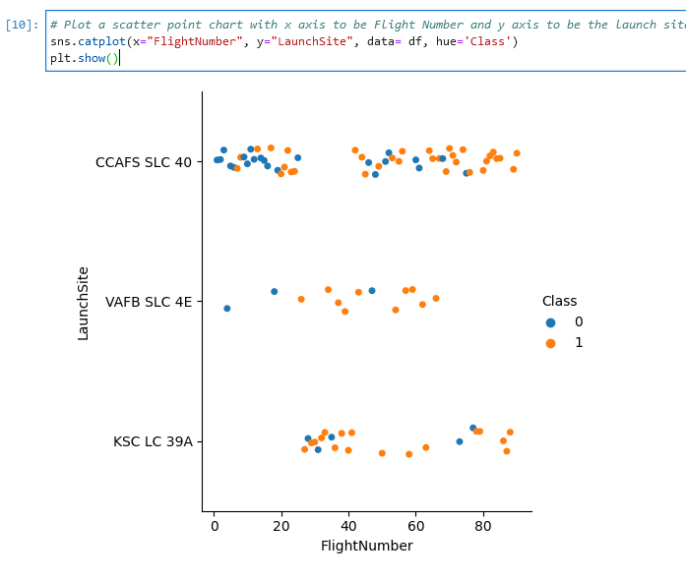
Flight Number vs. Launch Site
Show a scatter plot of Flight Number vs. Launch Site

Slide 18
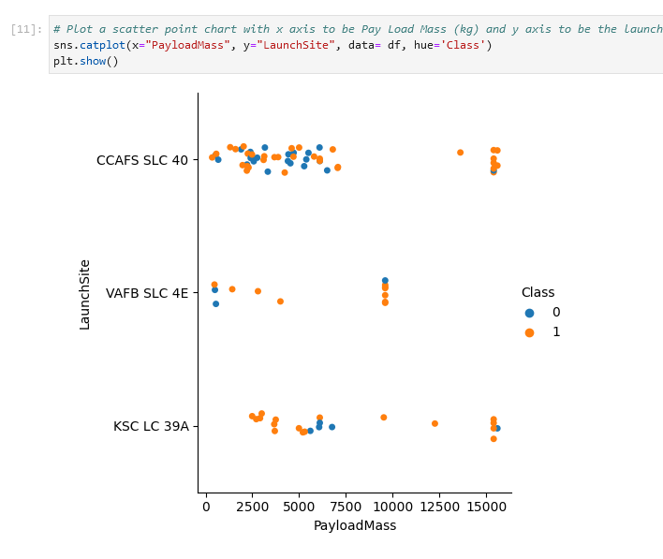
Payload vs. Launch Site
Show a scatter plot of Payload vs. Launch Site

Slide 19
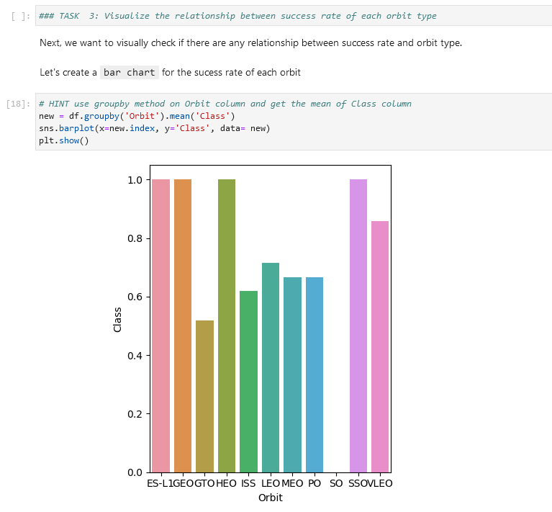
Success Rate vs. Orbit Type
Show a bar chart for the success rate of each orbit type

Slide 20
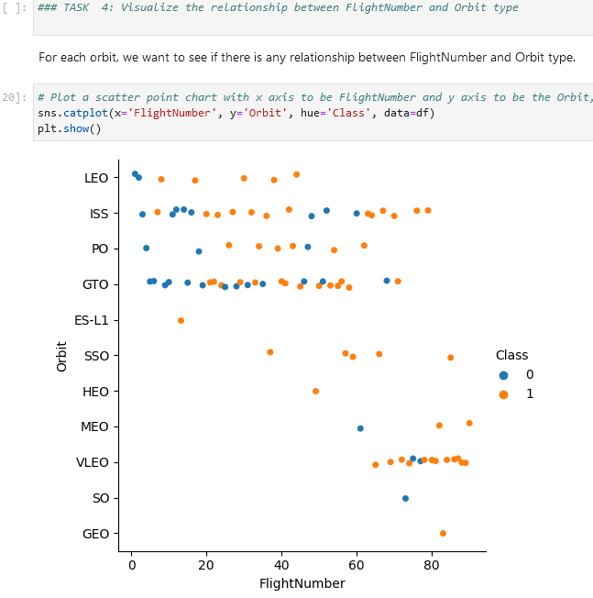
Flight Number vs. Orbit Type
Show a scatter point of Flight number vs. Orbit type

Slide 21
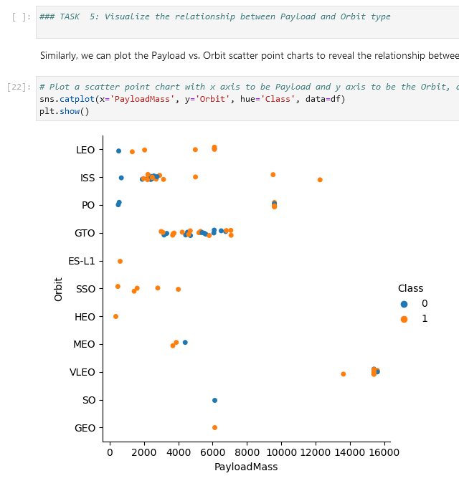
Payload vs. Orbit Type
Show a scatter point of payload vs. orbit type

Slide 22
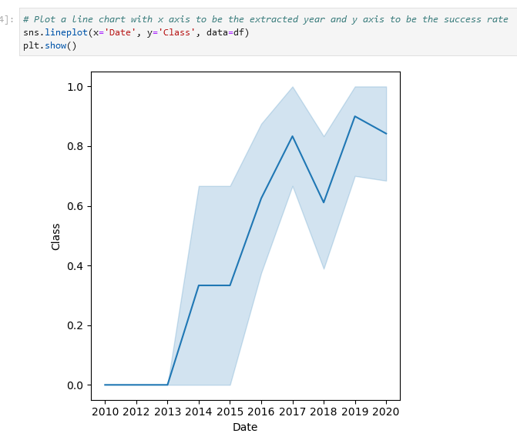
Launch Success Yearly Trend
Show a line chart of yearly average success rate

Slide 23
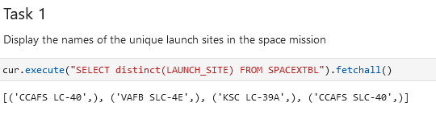
All Launch Site Names

Slide 24
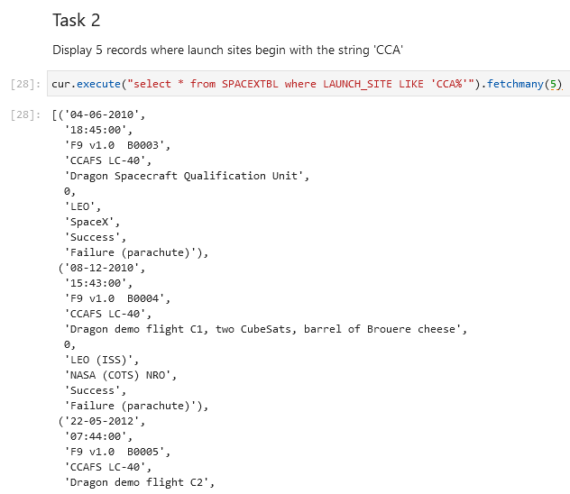
Launch Site Names Begin with 'CCA'
Find 5 records where
launch sites begin with `CCA`

Slide 25
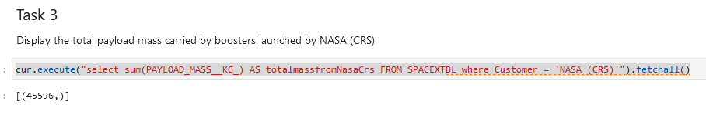
Total Payload Mass
Calculate the total payload carried by boosters from NASA

Slide 26
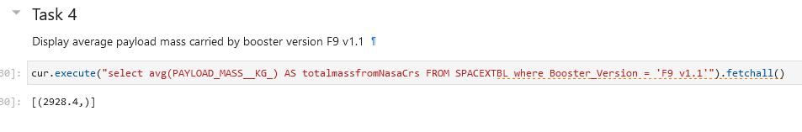
Average Payload Mass by F9 v1.1
Calculate the average payload mass carried by booster version F9 v1.1

Slide 27
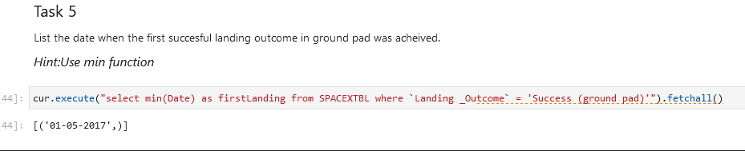
First Successful Ground Landing Date
Find the dates of the first successful landing outcome on ground pad

Slide 28
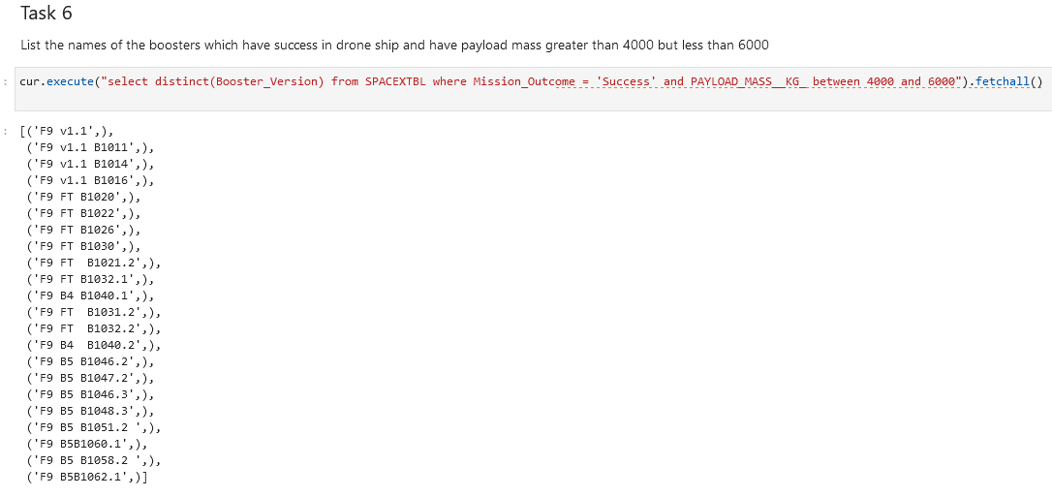
Successful Drone Ship Landing with Payload between 4000 and 6000

Slide 29
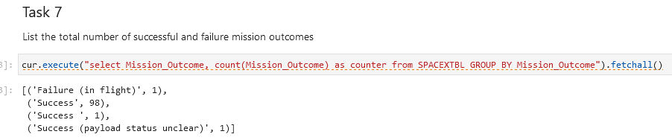
Total Number of Successful and Failure Mission Outcomes
Calculate the total number of successful and failure mission outcomes

Slide 30
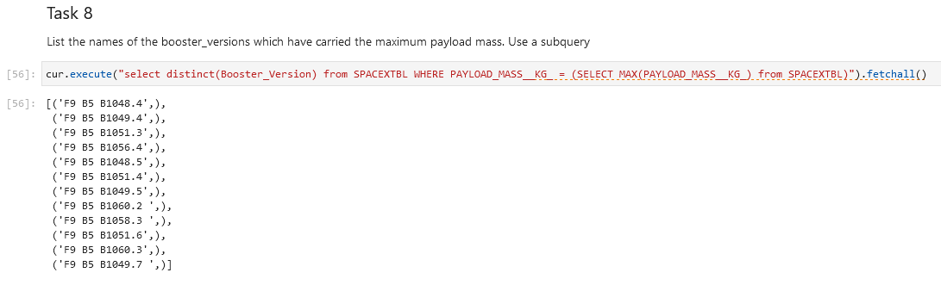
Boosters Carried Maximum Payload
List the names of the booster which have carried the maximum payload mass
Present your query result with a short explanation here

Slide 31
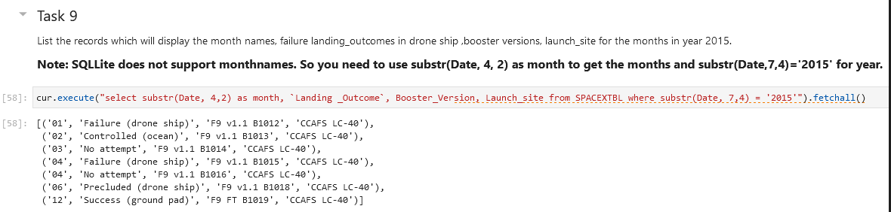
2015 Launch Records
List the failed landing_outcomes in drone ship, their booster versions, and launch site names for in year 2015

Slide 32
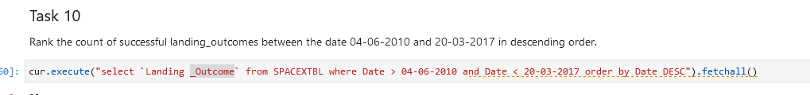
Rank Landing Outcomes Between 2010-06-04 and 2017-03-20
Rank the count of landing outcomes (such as Failure (drone ship) or Success (ground pad)) between the date 2010-06-04 and 2017-03-20, in descending order

Slide 33

Section 3

Slide 34
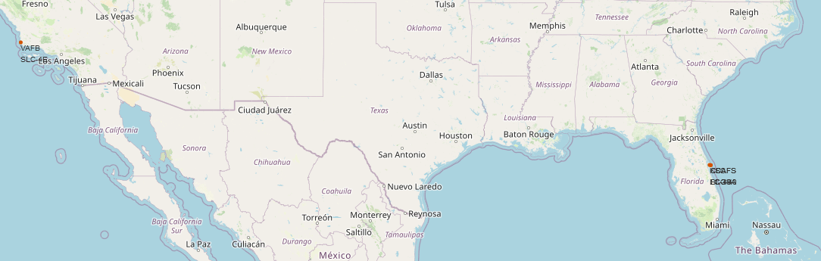
<Folium Map Screenshot 1>
All of them are in the USA

Slide 35
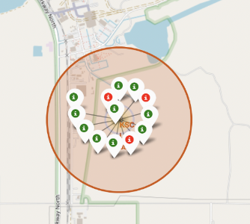
<Folium Map Screenshot 2>
Red: Unsuccessful landing
Green: Successful landing

Slide 36
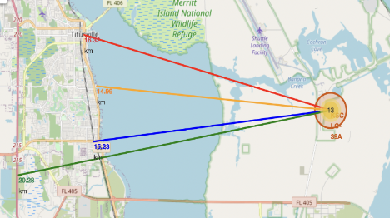
<Folium Map Screenshot 3>
bitCONNECT

Slide 37

Section 5

Slide 38
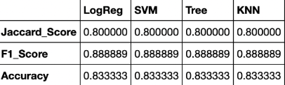
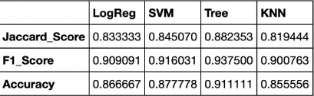
Classification Accuracy
Score of each model’s accuracy trained on test set
Score of each model’s accuracy trained on whole set
Tree method had the highest accuracy overall

Slide 39
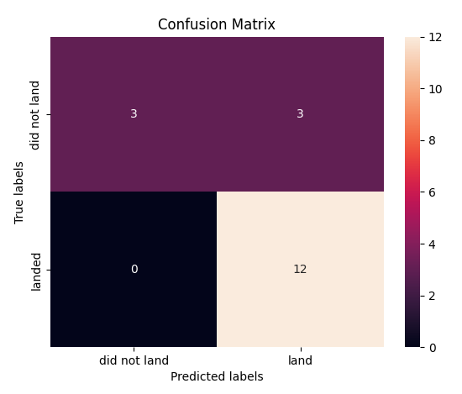
Confusion Matrix
This tree matrix can distinguish classes
Very accurate too!

Slide 40
Conclusions
Decision trees are the best for this dataset
Most launch sites are relatively close to the Equator line and all of them are on the beach.
As time passes the success rate of launches increases

Slide 41


